Slide 1
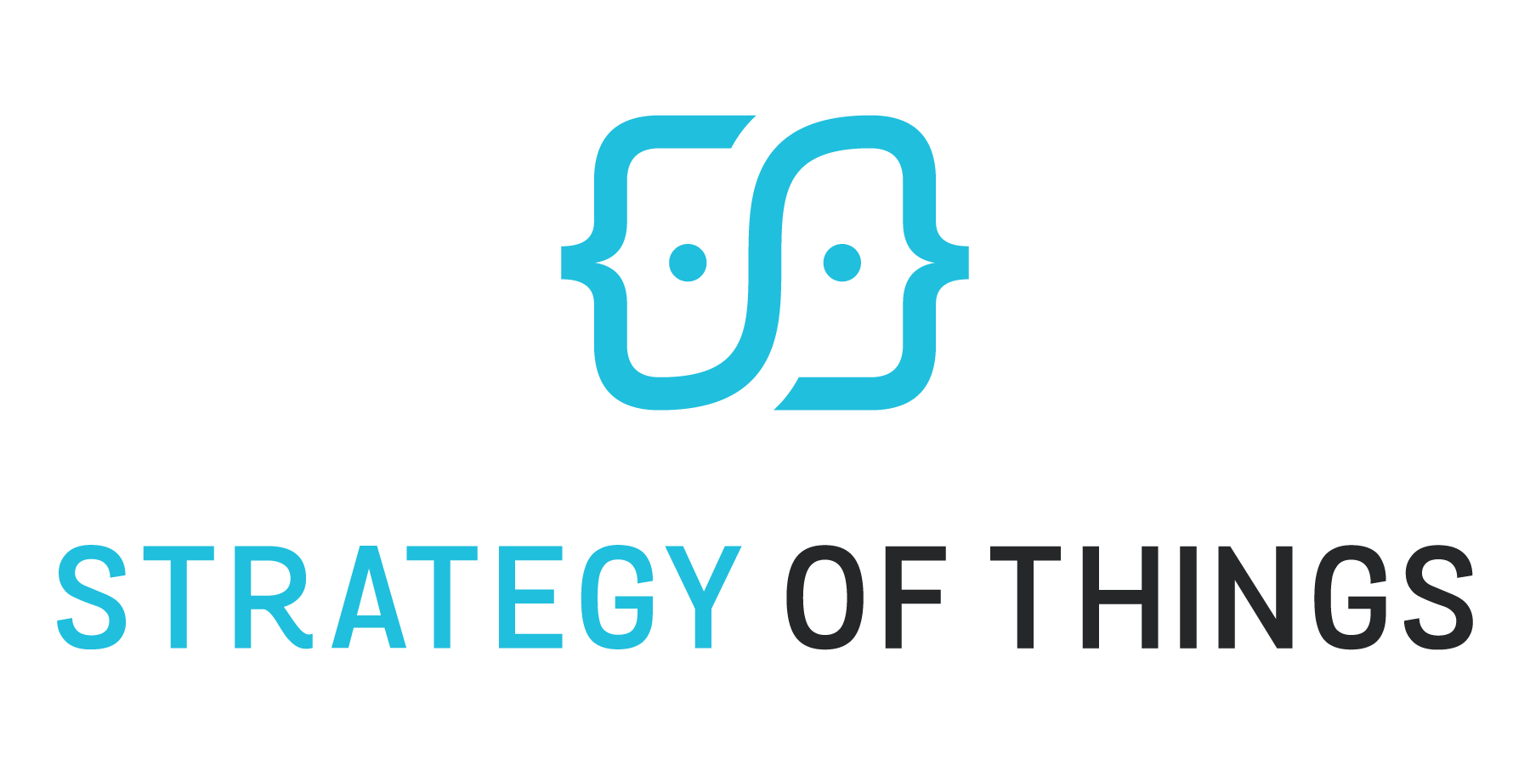
Key Skills for IoT Integrators
Benson Chan, Senior Partner
July 9, 2018

Slide 2
About Strategy of Things
Strategy of Things is a Silicon Valley based innovation consultancy helping organizations transform with disruptive technologies. We focus in the areas of smart cities, buildings and factories.
Advisory
What can I do and how?
Strategy and Planning.
Research
How do I keep up to date and have the latest best practices?
Insights and training.
Innovation Lab
Am I creating the right solutions?
Rapid prototyping and customer validation.
Acceleration
How can I implement and roll out the solution?
Implementation, go-to-market and change management.

Slide 3
Topics
What is IoT?
Why are new skills needed?
What are the IoT skills?
Strategies for skills acquisition
Q&A

Slide 4
Topics
What is IoT?
Why are new skills needed?
What are the IoT skills?
Strategies for skills acquisition
Q&A

Slide 5
A functional view of the Internet of Things
Mobile App
Hardware
Software
Radio
Actuator
Sensor
Device or “Thing”
Internet
Web Browser

Slide 6
What is the Internet of Things (IoT)?
Things
Connect
Transform
Integrate
Use
Edge/Fog
Cloud
Local or On Premise
Things
Sensors
Actuators
Meters
Devices
Wireless Technologies
Short range (BT, NFC, Wi-Fi)
Long range (cellular, LPWAN)
Radio
IoT Platform
Collect
Normalize
Process/Rules/Policies
Analyze + Respond
AI and automation
Store
Execution Systems
Business Applications
Operations Applications
Industrial Applications
Edge Mgmt
Controllers
Processors
Storage

Slide 7
The Data of Things
Things
Connect
Transform
Integrate
Use
Collect Physical
Data
Transform Data Into Insights
Optimize Outcomes
Edge/Fog
Cloud
Local or On Premise
Things
Sensors
Actuators
Meters
Devices
Wireless Technologies
Short range (BT, NFC, Wi-Fi)
Long range (cellular, LPWAN)
Radio
IoT Platform
Collect
Normalize
Process/Rules/Policies
Analyze + Respond
AI and automation
Store
Execution Systems
Business Applications
Operations Applications
Industrial Applications
Edge Mgmt
Controllers
Processors
Storage

Slide 8
IoT is a combination of hardware, software, open standards, connectivity, data and business models
Use Case/Industry Segments
Manufacturing
Oil and Gas
Smart City
Healthcare
Automotive
Transportation
Enterprise
Presentation Components
Mobile OS
Web Browser
Virtual Reality
Aug. Reality
Voice Interface
Vehicle Interface
Wearable Interface
Platform Components
Infrastructure
Compute
Storage
Database
Manage Edge
Register
Provision
Monitor/Track
Manage Data
Ingest
Transform
Store
Secure
Access Ctrl
Authenticate
Encrypt
Integrate
API
Services
Optimize
Rules
Analytics
ML/AI
Operate
Admin
Workflow
Billing
Build Applications
Tools & Framework
Personalize/Rules
Visualize/Model
Report
Metrics
Logs
Notifications
Messaging Protocols
MQTT
REST
CoAP
HTTP
AMQP
DDS
XMPP
WebSocket
Other
Connectivity and Gateway Components
Wifi
Bluetooth
Zigbee
Z-wave
5G/4G/3G/2G
NB-IoT
Weightless
Symphony
RPMA
SigFox
LoRa
Devices and Things
Robots
Vehicles
Drones
Edge Platforms
Sensors
Actuators
Edge Devices

Slide 9
Topics
What is IoT?
Why are new skills needed?
What are the IoT skills?
Strategies for skills acquisition
Q&A

Slide 10
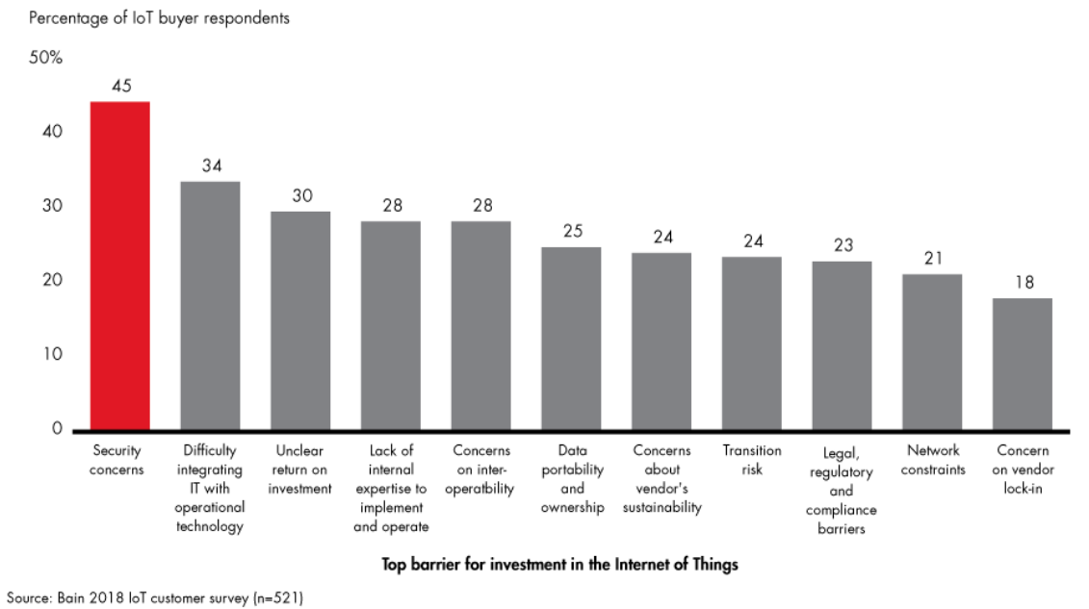
What is stopping buyers from buying?
Source: http://www.bain.com/publications/articles/cybersecurity-is-the-key-to-unlocking-demand-in-the-internet-of-things.aspx

Slide 11
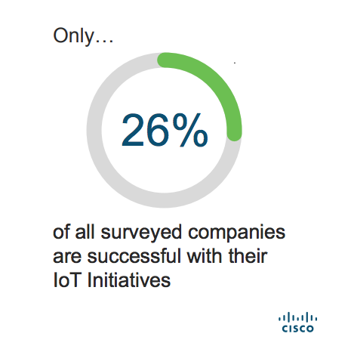
Why do IoT projects fail?
Reasons for failure
Source: https://www.slideshare.net/CiscoBusinessInsights/journey-to-iot-value-76163389 May 2017

Slide 12
Topics
What is IoT?
Why are new skills needed?
What are the IoT skills?
Strategies for skills acquisition
Q&A

Slide 13
Key Skills Summary
Technology
Execution
Value
Data
Analytics
Cybersecurity
IoT Project Management
Customer Success
IoT Solution Development
IoT Systems Integration
Maker
Software Application Development
Change Management
Consultative Sales
Notes:
Confusion
Lots of solutions, point solutions
Security is getting better
450 + platforms
Multiple connectivity options
More suppliers than buyers
Not a lot of big projects, but lots of pilots and small tests
¾ of IoT projects fail
Infrastructure players are making money

Slide 14
Skill: Cybersecurity
What is it?
Prevent, Protect, Mitigate, Respond, Recover
Device, Communications, Cloud, App, Data
Why do you need it?
IoT adoption barrier
Critical shortage of experts
No longer someone else’s problem
Liabilities
What will you be able to do with it?
Cybersecurity strategy and planning
Systems architecture analysis/design/engineering
Security systems integration
Security solutions implementation
Systems audits and assessment
Security systems administration
How:
University/online coursework
Industry-specific training
Vendor training
Conferences
Security is broad - develop general competence first. Develop specializations strategically.
Popular Certifications
CISSP (high level)
CISA (auditing)
CISM (managerial)
GICSP (industrial infrastructure)
CompTIA Security+ (basics)
GSEC (basics)

Slide 15
Skill: IoT solutions development
What is it?
Create IoT solutions – device to cloud to app
Pilots to production applications
Why do you need it?
Limited commercial solutions available
Pilot and innovation projects
Market availability of IoT development tools
What will you be able to do with it?
Solution planning and design
Rules and policies
Software application development
Mobile application development
API and software integration
IoT connectivity and networking
Hardware/software integration
How:
Online training
Hands on lab work
Vendor based training programs
IoT Bootcamps (1 day, 1 week…)
Many vendors provide hardware and software development kits. Some vendors offer platforms that minimize coding and integration.
Popular IoT development tools and platforms
IoT software platforms – Particle, Ayla, Exosite, Helium
Cloud platforms – AWS, Microsoft, IBM, ThingWorx, etc.

Slide 16
Skill: Software application development
What is it?
Create the desired functionality for IoT devices
Server, cloud and mobile applications, UI/UX, web
Backend, frontend
Why do you need to do it?
IoT solutions are point solutions that work independent of other IoT solutions or connected to business or operations systems
Current solutions have limited functionality
Customer specific IoT devices and applications
What can you do with it?
Custom IoT software applications
Customized and integrated dashboards
Mobile applications
How:
University/online training
Coding bootcamps
Strategic recruitment
There is not one universal coding language used in IoT. Depending on where in the stack, the type of application, will drive what is used.
Popular Languages
Java, Python
C/C++ (embedded)
Javascript
Go
PHP
Swift (iOS apps)

Slide 17
Skill: IoT Project Management
What is it?
Manage the deployment of IoT solutions
Hardware, communications, software, data
Vendors and ecosystems
Why do you need it?
75% of IoT projects fail
Small projects have enterprise level complexity
“no man’s land” within an organization
Limited internal and external expertise
Dynamic technology and vendor ecosystem
What can you do with it?
Complex project planning and execution
Multi-vendor ecosystem projects
Agile learning and adaptation
How:
Online or live training – IoT, PM, agile, systems thinking
Vendor methodologies and training
Conferences
Managing IoT projects require deep understanding of complex PM methodologies. PMs must be agile, adaptive, fast assimilators and strong communicators in highly uncertain environments.
Popular Certifications
PMP
CAPM
PMI-ACP (agile)

Slide 18
Skill: IoT Systems Integration
What is it?
Make IT, OT and IoT work together
Make the various IoT components work together
Why do you need it?
Extension of what you are already doing
No end to end solution in the marketplace today
Strong market demand – integration is hard
Key to IoT adoption by customers
What can you do with it?
IoT systems strategy and planning
Systems architecture analysis/design/engineering
Hardware, software, cloud platform integration
End to end systems test and optimization
Procurement planning and strategy
Infrastructure futureproofing
How:
Online training programs
Industry association training programs
Vendor training and workshops
Internal knowledge sharing
Mentoring and coaching
Systems integration is broad - develop general competence first across hardware, software and platforms. Develop specializations strategically for solutions and platforms as needed.
Popular Certifications/Programs
Platform – IBM, AWS, Microsoft, ThingWorx, etc.

Slide 19
Skill: Change Management
What is it?
Approach to drive change, transition and adoption
People focused – employees, customers, channel
Why do you need it?
IoT disrupts businesses, operations, and processes
People don’t like change, even if change is good
The more disruptive, the greater the resistance
Technology is not enough - projects fail to realize its ROI and outcomes if people don’t support it
What can you do with it:
Identify scope, and who and how impacted
Change/transition strategy and planning
Risk identification and mitigation
Communications and execution
Trust building
How:
University/online coursework
In person workshops
Hire change managers
Popular Certifications
Certified Change Management Professional (CCMP)
Change Management Specialist (CMS)
Certified Problem and Change Manager (CPCM)
Change Management Certificate Program from the Association for Talent Development
Prosci Change Management Certification
APGM Organizational Change Management Foundation
AIM Change Management Certification

Slide 20
Skill: Data Analytics
What is it?
Turn data into insights that can be acted upon
“Connecting the dots”
Why do you need it?
Real value of IoT is in the data
Customers buy outcomes, not technology
Most customers don’t have this capability
Critical shortage of data analysts in the market
High value service customers willing to pay for
What can you do with it?
Find and frame problems to be solved
Create new data science services offerings
Data aggregation from multiple sources
Data analysis and insights creation
Strategic recommendations and solutions
How:
University/online coursework
Industry-specific training
Recruit data analysts
Vendor/tools training programs
Conferences
Data is critical, but when combined with domain and operation, “connects the dots” and yields insights
Popular Certifications/Programs
Certificate Programs – UCSD, Columbia, Harvard, Georgetown
Vendor programs – Cloudera, IBM, Dell, SAS, Microsoft

Slide 21
Skill: Customer Success
What is it?
Help customers get the most from their solutions
Multidisciplinary - Technology, Marketing, Sales, Pro Services, Training, Support, Relationships
Why do you need it?
Solutions increasingly are offered “as a service”
Ensure customer satisfaction and outcomes
Minimize churn and maximize customer retention
What will you be able to do with it:
Account and customer relationship management
Project and program management
Solutions implementation and optimization
Processes/operations analysis and optimization
Problem identification, assessment and solving
New opportunity identification
How:
Online training programs
CS Manager boot camps
Hire Customer Success trainers
Hire experienced CS team and managers
Internal knowledge transfer and sharing
Mentoring and coaching
Popular Certifications
Various “certifications” are offered by solutions vendors (e.g. Cisco) or consulting/training companies

Slide 22
Skill: Maker
What is it?
Create, tinker, build models and prototypes
Experiment, test, hands on “problem solver”
Why do you need it?
No commercial solution available
Low cost prototyping to prove viability
Technology demonstrations
Learning and training
Problem solving in the field
What can you do with it?
Build prototypes from concepts
Build pilots for new product offerings
Create solutions for customers
How:
Online videos
Vendor training workshops
Maker workshops
Broad skill ranging from creating things with 3D printing, prototyping with Raspberry Pi/Arduino, to developing code on IoT prototyping platforms.
Popular Certifications
N/A

Slide 23
Skill: Consultative Sales
What is it?
Sales approach focused on collaboration, needs
Sales rep as a trusted advisor and problem solver
Find problems first, identify solutions second
Why do you need it?
Problems solved by IoT are still to be discovered
Problems addressed by IoT cross org boundaries and disciplines
IoT offerings are not “box” sales
New business and services opportunities
What will you be able to do with it?
Broader scope problems and needs discovery
Collaborative problem identification and solving
Opportunity identification
Strengthen current and expand new relationships
How:
Hire a consultative sales trainer
Recruit consultative sales mgmt
Recruit consultative sales reps
Practice/Roleplaying
Mentoring and coaching
Not all services or solutions, IoT or otherwise, need to be sold “consultatively”. This type of sales approach works best when you are able to establish your expertise and recognition first.
Popular Certifications
N/A

Slide 24
Topics
What is IoT?
Why are new skills needed?
What are the IoT skills?
Strategies for skills acquisition
Q&A

Slide 25
Getting the skills – short and long term approaches
Short Term (0 to 24 months)
Gap Filler, One-offs, Knowledge Transfer
Long Term (24 months +)
Capability Investment, Scaling, Buildout
Contractors
Outsource
Training (internal or external)
Recruitment
Short Term Partnerships
Training (internal or external)
Strategic Outsourcing
Strategic Partnerships
Notes:
Infrastructure modernization for digital transformation - infrastructure, core skills, tools and resources
Firmware updates
Network upgrades/repairs to support bandwidth, network segmentation to separate out IoT networks
Moving data to cloud services
Wireless connectivity
Data warehousing, cleanup, etc.
Security
Policies – data, privacy, etc
Integration of system and application
Inventory of assets, applications, etc.
Roadmap of what to change to get to future stage
Fix processes and poloicies
E.g. selling a service on a monthly basis, new business models
Audit skills and find new skills
Connecting the unconnected, extending connectivity – wire and unwired

Slide 26
Topics
What is IoT?
Why are new skills needed?
What are the IoT skills?
Strategies for skills acquisition
Q&A

Slide 27
Questions?
Benson Chan
Senior Partner
benson@strategyofthings.io
925-699-7562

