Slide 1
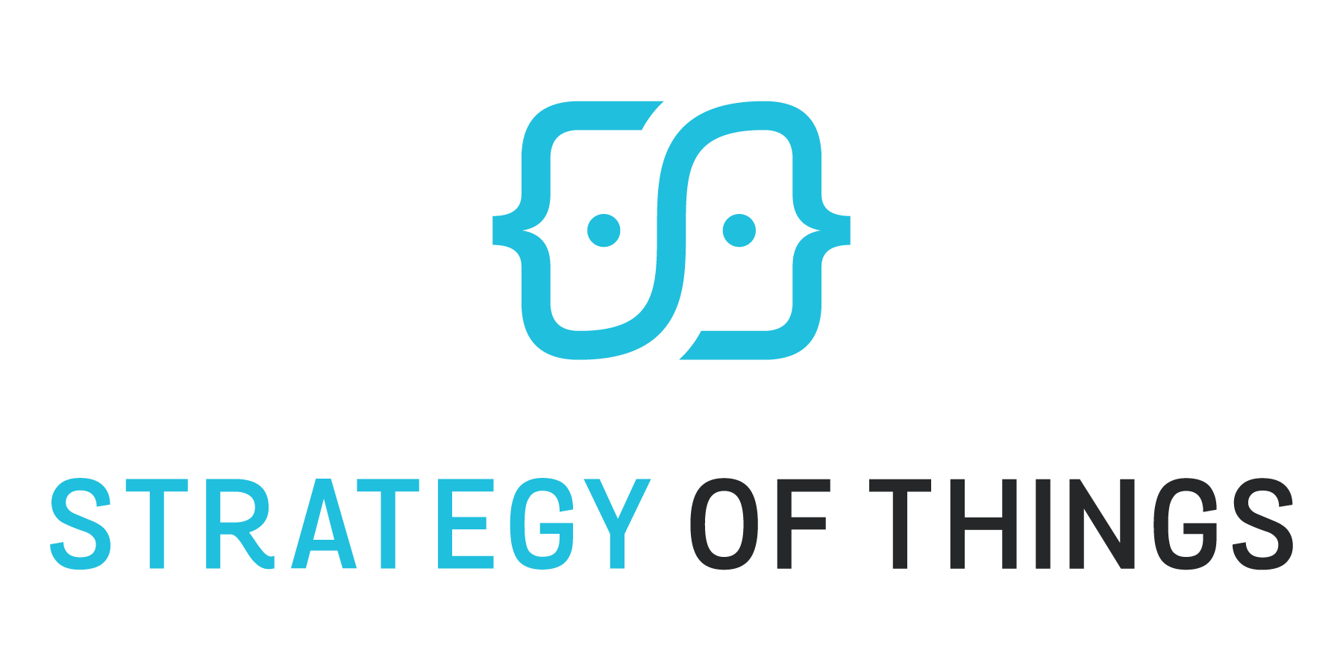
Marketing and Selling IoT
Through the Channel
Benson Chan, Senior Partner
May 8 2019

Slide 2
Topics
The Basics
Understanding the Channel
Enabling the Channel
Special Consideration

Slide 3
The best technology doesn’t always win. The best Go To Market does.

Slide 4
IoT is offered in new ways New paths to market may be required
Pre-Digital
Digital
“Thing”
IoT as a Service
Thing + “as a Service”
Hardware/Software
Maintenance Contracts

Slide 5
Paths to market for IoT solutions
Direct
Indirect Channel
Alliance
(OEM/Licensing, Co-marketing)

Slide 6
Each path has unique value and limitations
Direct | Control Margins Customer ownership | Limited Market Reach Limited Scalability Expensive
Channel (Indirect) | Time to market Market and geo reach Scalability Additional value-add Existing relationships Channel supports customer (L1) | Influence, not control Margins Channel owns customer
OEM/Licensing | Simple revenue model Extensibility across verticals Cost Licensee value and credibility Time to market | Several levels removed from user Partial revenue/customer Integration

Slide 7
There is no “one size fits all” best path to market
Company Lifecycle
Market Size
Solution Complexity
Channel Readiness
Solution Form Factor
Solution-Channel Fit
Market Conditions
Solution Maturity
Company Capabilities
Solution and Channel Economics
Customer Expectations
Company Business Model

Slide 8
Topics
The Basics
Understanding the Channel
Enabling the Channel
Special Consideration

Slide 9
The channel doesn’t work for you.
You work for the channel.

Slide 10
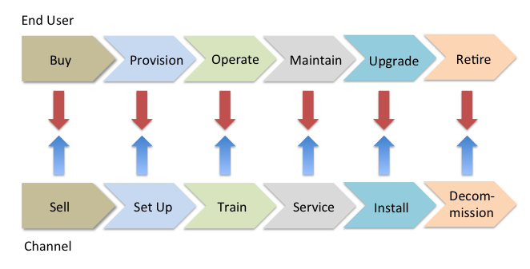
What is the role of the channel? More than just “reselling”…
Years
Channel “Value Added”
Solution lifecycle services
Professional services – planning, assessments, advisory
Digital/information services – “IoT” enabled services
Bundling/integration of disparate solutions
Financing vehicles and programs
Customer advocacy
Your IoT solution must design “product-market” fit over the lifecycle and the channel
Notes:
Product market fit needs to consider
The solution over the product lifecycle
The role of the integrator and the value they add
How the integrator will make money over the lifecycle, beyond the initial sale
Where the channel makes its money
Integrators only make a small portion of their money from reselling the solution. The solution margins can be thin, if there is a lot of competition.
A bigger portion of their revenues come from services, and servicing the customer.

Slide 11
How does the channel make money?
Years
Channel “Value Added”
Solution lifecycle services
Professional services – planning, assessments, advisory
Digital/information services – “IoT” enabled services
Bundling/integration of disparate solutions
Financing vehicles and programs
Customer advocacy
Solution Sales
Integration and installation
Maintenance and Support Contracts
Other Services
Consulting
Optimization
No matter how much value your solution provides to end users,
the channel will not market and sell your solution if it can’t make money from it.
Notes:
Product market fit needs to consider
The solution over the product lifecycle
The role of the integrator and the value they add
How the integrator will make money over the lifecycle, beyond the initial sale
Where the channel makes its money
Integrators only make a small portion of their money from reselling the solution. The solution margins can be thin, if there is a lot of competition.
A bigger portion of their revenues come from services, and servicing the customer.

Slide 12
Sell to the channel first BEFORE you sell through it
Relevance to Customer
Profitability
Solution Readiness
Reputation and Relationships
Replicable to Customer Base
Support

Slide 13
Selling IoT in the channel – competing priorities Manage your marketing to this reality
Money drives behavior.
Other Solutions in Portfolio
Existing deals in pipeline
40 – 60 working hours per week
Who is the actual buyer?
“Easy” Sells!

Slide 14
Topics
The Basics
Understanding the Channel
Enabling the Channel
Special Consideration

Slide 15
IoT channel success is controlled by partners. Focus on their enablement, productivity and profitability.

Slide 16
Key steps to selling IoT through the channel
Recruit and develop the channel that can best reach the buyers
1
Know who the real buyers are
2
3
Enable and manage the channel
ID and profile buyers
ID and profile channel partners
Source channel partners
Recruit channel partners
Onboard channel partners
Build partner effectiveness
Build partner productivity
Retain

Slide 17
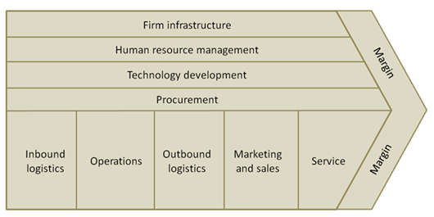
Who are your real IoT buyers?
1
IT Domain
Secondary
Activities
Primary
Activities
IoT Domain
IoT
IT

Slide 18
Who are your real IoT buyers?
1
Multiple Buyers Within an Organizations

Slide 19
Example: Location Analytics IoT Service buyers
1
Customer | Entity Type | Value Provided | Value Quantified
IT Department | Public | Metrics - Wi-Fi usage statistics and patterns Additional ROI – reuse of infrastructure for new tasks Potential IT service charge to other agencies | $
Economic Development | Public | Metrics – visibility into visitor and people patterns New insights to develop & validate new programs | $$
Transportation | Public | Metrics – visitor and people mobility patterns New insights to develop Transportation services Ability to measure pilot and planning effectiveness | $$
Sustainability | Public | Metrics – visibility into visitor and people patterns Ability to quantify carbon impacts | $$
Public Safety | Public | Metrics – visitor and people mobility patterns Public safety services planning Near real time services planning for events | $$
Chambers of Commerce | Private | Metrics – visibility into visitor and people patterns Services planning and programs to drive growth | $$$
Downtown Merchants Assn | Private | Metrics – visibility into visitor and people patterns Services planning and programs to drive growth | $$$
Merchants | Private | Metrics – visibility into shopper patterns Targeted promotions and campaigns | $$$

Slide 20
Channel recruitment
2
Develop Ideal Channel Profile
2
Source
3
1
Recruit
Current solution portfolio
Current service offerings
Skills and capabilities
Certifications
Geography
Areas of focus/Specialties
Customer base
Relationships
Company size
Industry reputation
Existing reseller base of complementary products
Distributors’ reseller base
Industry specific events and journals
Competitors reseller base
“Grow and develop” from existing base
“Value” case
“Two Way” fit
“Quick Win”
“Proof” points
Success stories

Slide 21
Onboarding the channel (1 to 90 days)
2
Days 1 – 30
Introduction
Days 31 – 60
Preparation
Days 61 – 90
Productivity
Administrative
Training
Solutions
Sales
Marketing programs
Tools
Account Planning
ID “pathfinders”
Account profiling
Goal setting
Task setting
Marketing and selling
Outreach
Meetings and education
Qualifying
Closing Quick Wins
Notes:
The most enthusiasm and attention occurs immediately when reseller is onboarded. Capitalize on that.
The most important thing is training. Get the training out of the way. Without the training, nothing else matters. Training is a form of commitment on the resellers part. If they can’t commit to training, then don’t waste your time.
Initial selling is to look for the quick wins – quick wins generate buzz, and further investments and commitment by the reseller.
In the beginning, you will give some commitment. The more the reseller commits, the more resources you put on the reseller. Don’t waste your valuable resources anywhere else.

Slide 22
Channel management – areas of focus
3
Volume
Profitability
Strategic programs
Relationships and loyalty
Top Tier
Few (15% of resellers)
30% of revenues
Middle Tier
High productivity gains
~ 35% of resellers
~ 50% of revenues
Effectiveness
Productivity
Skills development
Market development
Loyalty
Basic
Large # of resellers (~50%)
Low $$ per reseller (~20%)
Education/Training
Skills development
Screen
“Graduate” to next tier

Slide 23
Channel productivity and effectiveness
3
Training and Development
Marketing/sales tools
Content and Messaging
Key skills development
Data
Other digital skills
Solutions education
Sales training
Marketing training
Technology and support
Channel
Sales playbook
Field One Pager (cheat sheet)
Demo accounts/NFR
Customer
Solutions data sheet (1-2 pager)
Mini-videos
Case studies/Success stories
“Cut and Paste”
Videos vs. Text
Co-branding

Slide 24
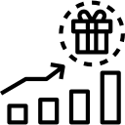
Channel marketing and programs
3
Promotions
Channel Incentives
Profitability
Solution pricing
Solution offers
Training credits
Financing
SPIFFs
Performance bonuses
Training bonuses
Credits
Marketing funds
Deal protection
Volume incentives
Deal protection

Slide 25
IoT Channel Enablement Framework
3
High Reach,
Low Touch
Increase Awareness
Grow existing or new base
“Get in the Game”
“Jumpstart the Interested”
Sales and Marketing Enablement
Direct Action on “Top 10”
Directly Engage the Top Ten
Low Reach,
High Touch

Slide 26
IoT Channel Enablement Model (examples)
3
Awareness
Driving “Top of Mind”
Adoption
“Commitment to Action”
Tools
“Enabling Execution”
Measure/Manage
“Ensuring Execution”
General Awareness Webinars
Recruitment webinars
Website
Advertising
Targeted Press Stories
Intro promotions
Basic training pdf
Demo videos (training)
Reseller/customer testimonials
Number of basic training sessions
# of people trained
# of organizations trained
# unique visitors to website…
Get in the Game
Distributor training
Reseller training
Newsletters
Quick Start Business Development Program
NFR demo purchase program for reps
Resources webpage
Customer facing brochures
Case studies
Marketing banners, text for resellers, sample gifs,
Sales objections, tools, best practices
# of trainings
# of reseller outreaches
of visits to website
# of resellers trained
Units/solutions sold
Rev & # per disty
# resellers converted
Jumpstart
Targeted reseller live trainings
Targeted dealer emails/calls
Spiff
Joint Marketing program
Demo Purchase Program (credit applied on sales)
Reseller sales plan
Co-branded brochures
Joint case studies
Hard copy literature
# of target partner outreaches
# of trainings
# of target dealers trained
# of follow-ups post training
Rev/units per disty
Rev/units per target reseller
Engage Top Ten

Slide 27
Topics
The Basics
Understanding the Channel
Enabling the Channel
Special Considerations

Slide 28
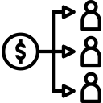
Special Considerations
Sales Compensation
instant gratification vs. recurring
New Skillsets
Digital skillsets
Consultative selling
Customer success
Organization and Process Alignment
Organization
Operational infrastructure
Business and Revenue Disruption
Greenfield opportunities
Competitive takeout

Slide 29
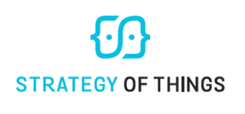
Questions?
Benson Chan
Senior Partner
benson@strategyofthings.io
925-699-7562

